Slide 1

Notes:
Encourage communication with team leaders to set achievable goals.

Slide 2

Notes:
Discuss how to seek clarity on tasks, responsibilities, and expectations.

Slide 3

Notes:
How am I been evaluated? My goals, my manager goal? The team goal?

Slide 4
How to contribute?

Slide 5
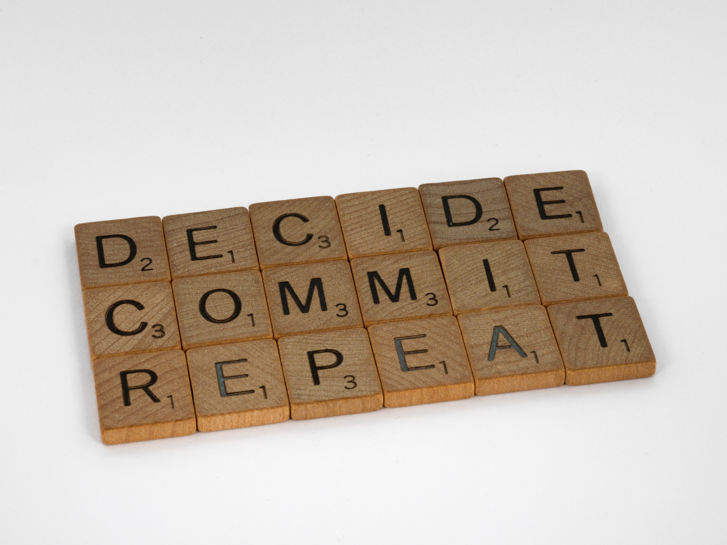
Notes:
Guide students on how to actively participate in team projects.

Slide 6

Notes:
Encourage them to leverage their unique skills and perspectives.

Slide 7
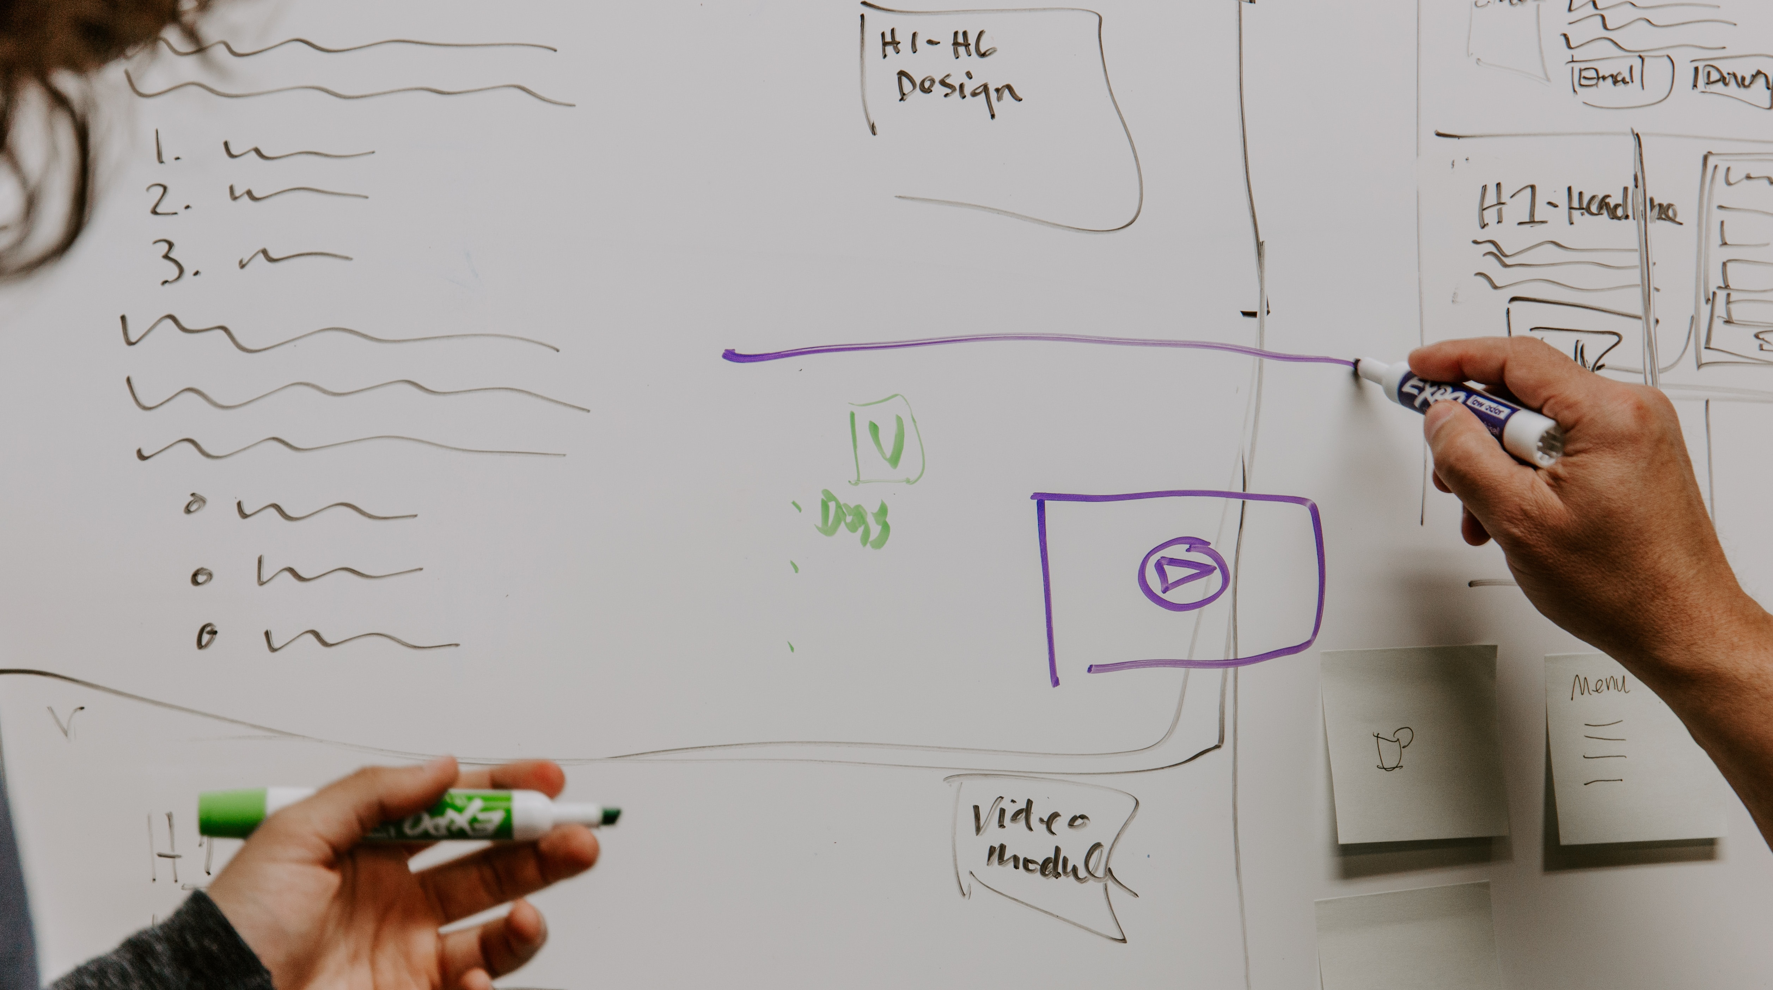
Notes:
Documentation… Your are going to learn and discover that a lot of what you learn and do lake documentation.

Slide 8
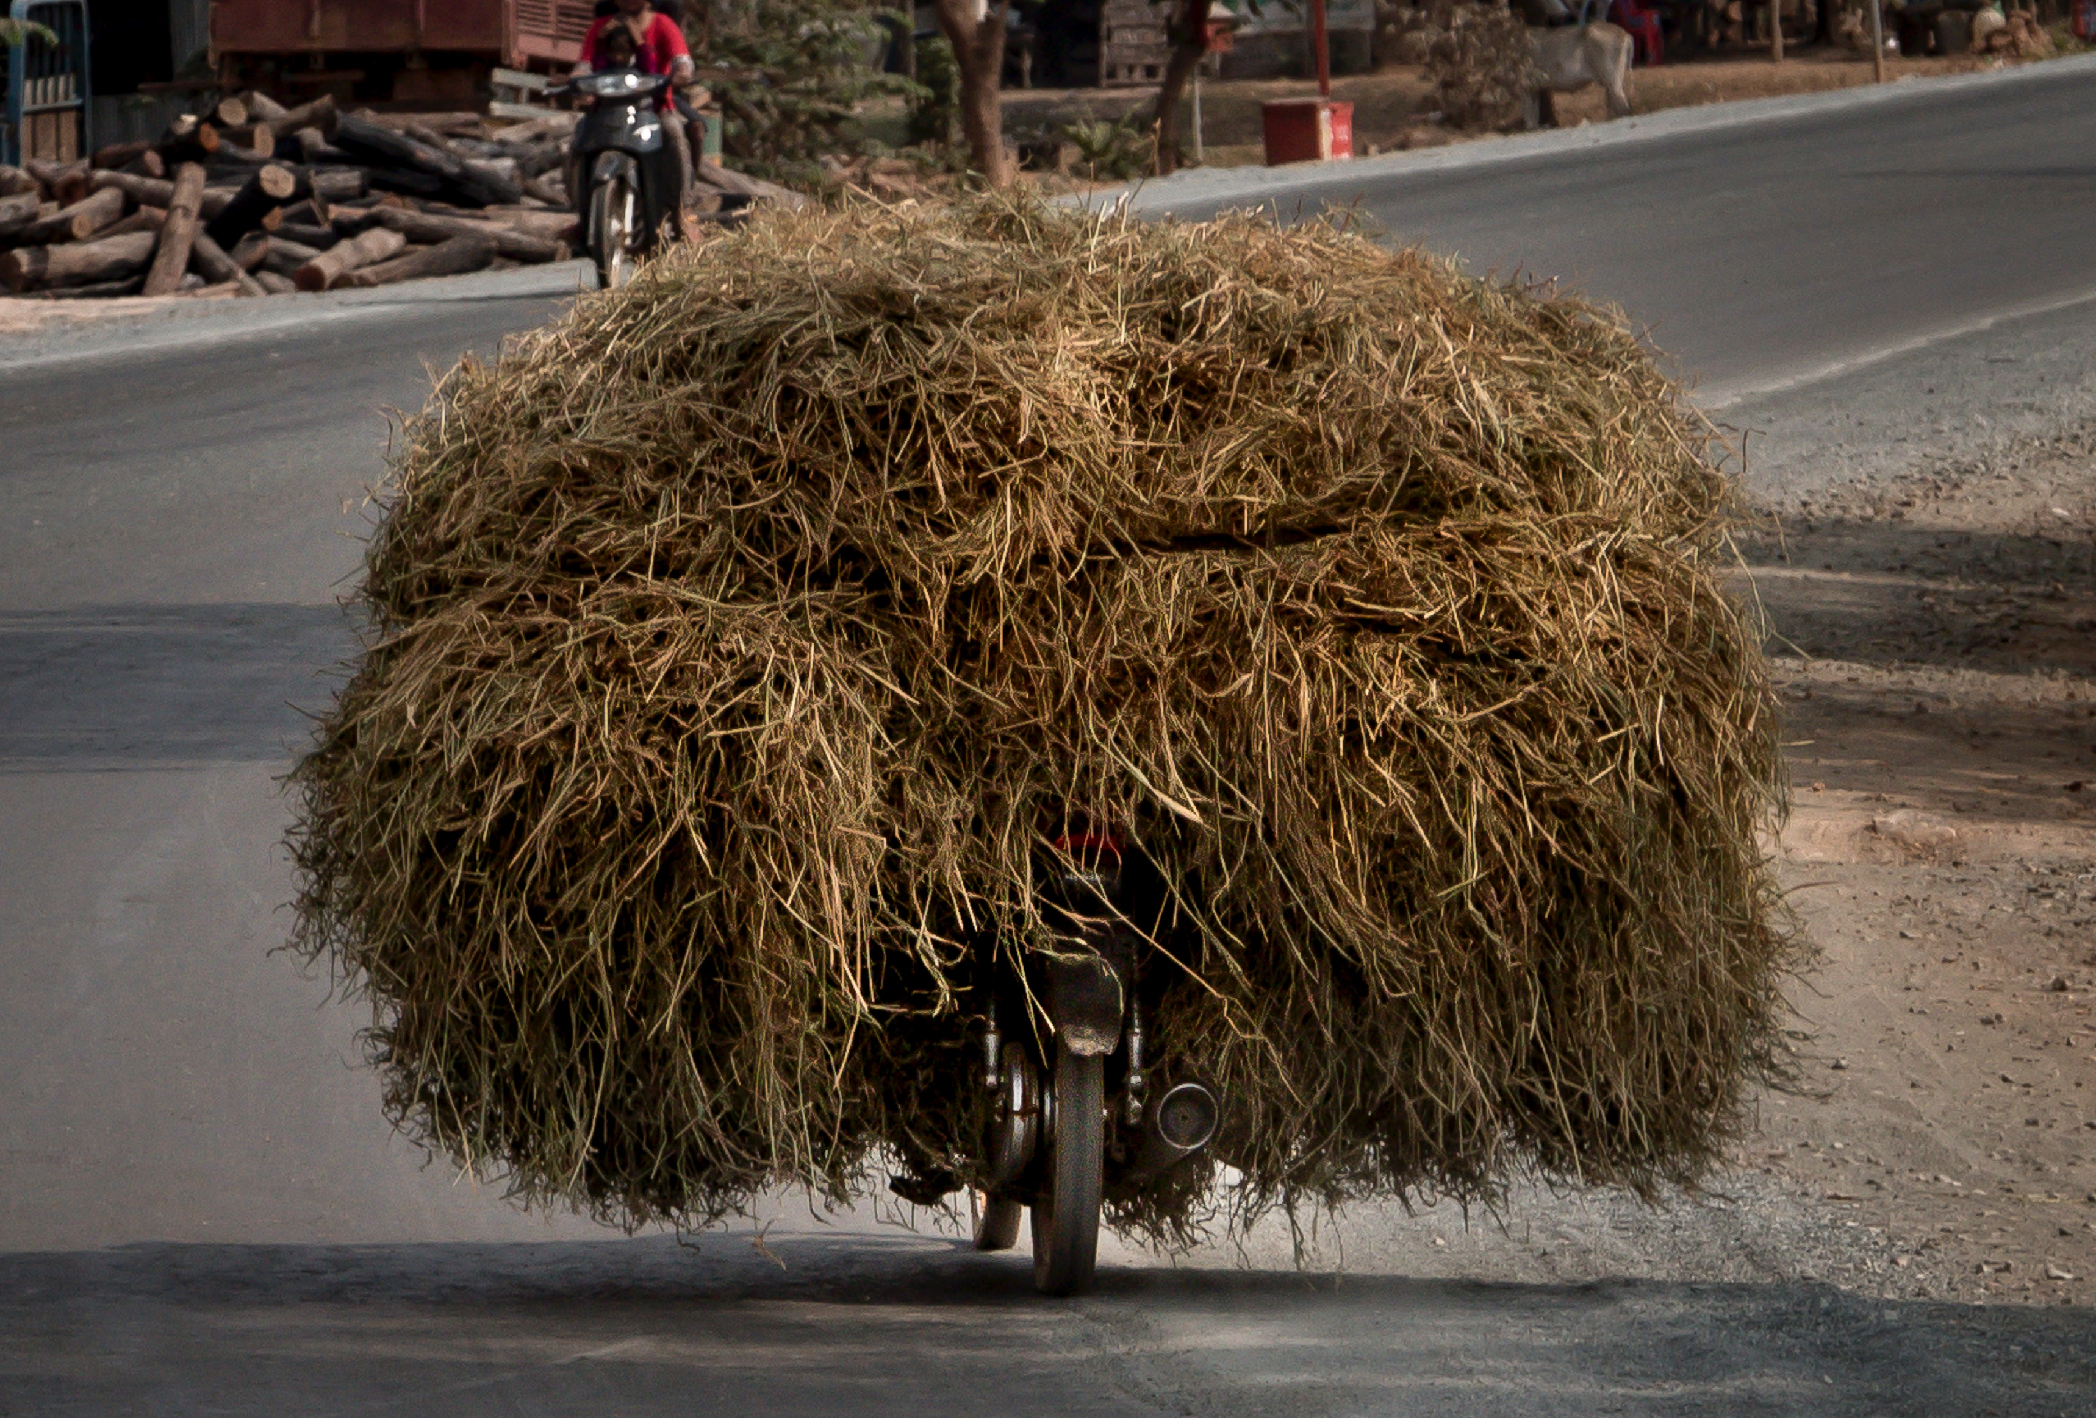
Notes:
Managing expectations: Workload expectations
That’s too much for me…
That’s too easy…

Slide 9

Conflict resolution dynamic
Notes:
Conflict Resolution Team Building Activity (Show some escenarios of conflicts at work and ask students to debate possible solutions.)

Slide 10
Challenges & conflicts
Notes:
Dealing with Challenges and Conflict (10 minutes)

